Slide 1





ELEGANT MANGOES DATA ANALYTICS
App acquisition recommendation report for
App TraderTM
Elegant Mangoes
Rachel Hertel, Trey Bourgeois, Tim Pearson,
Scott Boyer and Yared Gabre
Acquisition and Merger Consultants
Acquire BetterTM

Slide 2
App Acquisition Strategy
Elegant Mangoes evaluated App Store and Google Play platforms to identify the 10 best Apps for App Trader to acquire for Black Friday 2021
Key Metrics Considered
Rating
Install Count
Review Count
Shared Platform Availability
Target Demographic?
Target Genre?

Slide 3
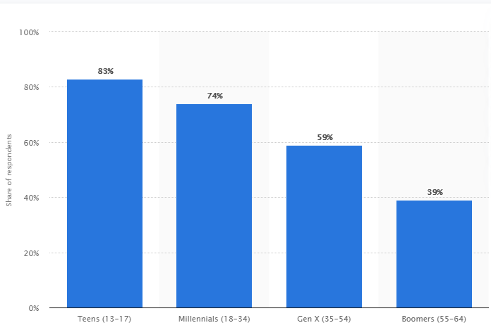
Target Demographic: Teens & Millennials
Share of mobile device owners who download apps at least once a month or more, by age group, United States
Teens and Millennials download more apps per month than any other demographic segment, with over nearly 80% of this segment downloading at least one or more apps per month
Source: Statista 2021, data as of April 2018

Slide 4
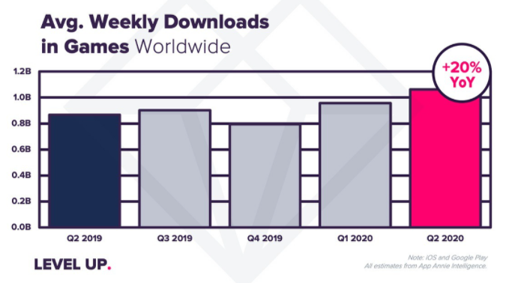
Target Genre: Games
Average global weekly game downloads, Q1 2019 – Q2 2020
Games is the hottest genre in the app market, with 20% YoY growth in weekly downloads since Q2 2019
Source: App Annie via VentureBeat
Notes:
YoY growth was 20%...but can this growth continue?

Slide 5
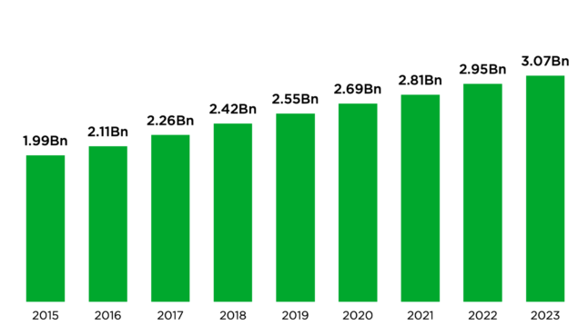
Forecasted Growth in Games
Global growth of the Games genre is expected to continue, with over 2.5 billion global users by 2023 and forecasted revenue of $200 billion
59% of mobile gamers are in the teen/millennial demographic*
2015-2023 Forecasted Growth in Global Gamers
Source: Newzoo 2020 Global Games Market Report
*Source: Statista 2020
Notes:
Transition: So clearly games is the hottest genre in our market research, but how does that translate to % share in App/Play stores?

Slide 6
Game Genre in Across Platforms
Distribution of apps by genre in Apple and Google Play stores
Games was the dominant genre (53%) among apps appearing in both Apple and Google Play stores in 2020
Notes:
Our analysis of the data revealed Games was the dominant genre (53%) among apps appearing in both Apple and Google Play stores in 2020

Slide 7
10 Apps for Black Friday
Asphalt 8: Airborne
Bullet Force
Choices: Stories You Play
Deck Heroes: Legacy
Call of Duty: Heroes
Fallout Shelter
Final Fantasy Brave Exvius
Hungry Shark Evolution
Hungry Shark World
PewDiePie's Tuber Simulator
Rating
>= 4.5
Review Count
> 445K
Install Count
> 5M
Demographic and Genre
Age 13-34
Shared Platform
Alternate Recommendations
Injustice: Gods Among Us
The Simpsons: Tapped Out

Slide 8

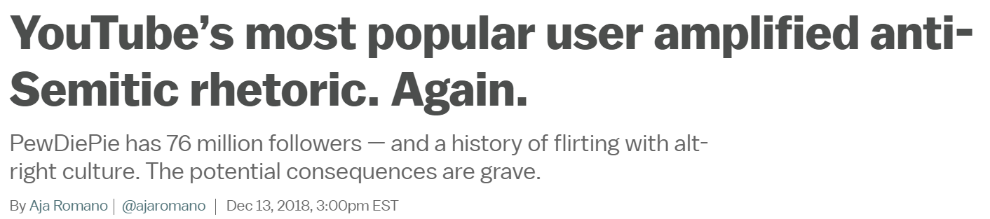
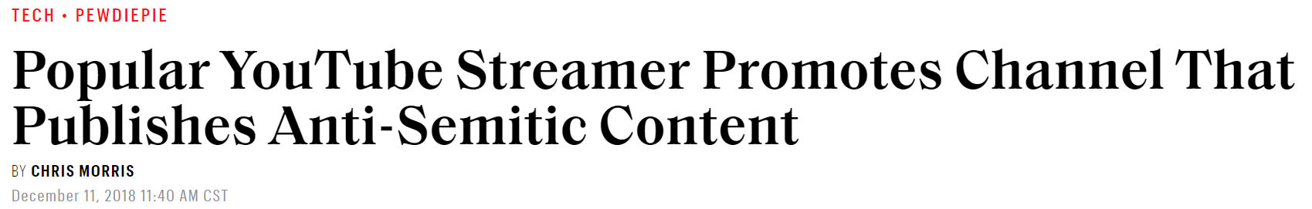
Additional Considerations: Our work with Acquire Better
Acquire Better, an acquisition and merger consultancy, has identified risk associated with PewDiePie, the inspiration for PewDiePie Simulator

Slide 9
Return on Investment
Average longevity per app: 10 years
Average Annual Income per app: $120K
Income Over 10 years per app: $1.2M
Total Projected 10-year income (all apps): $12M
Notes:
So if you go with these recommendations, what’s the pay-off?
**Note: An app appearing in both stores makes $10,000 per month

Slide 10
THANK YOU
Comments / Questions?

Slide 11
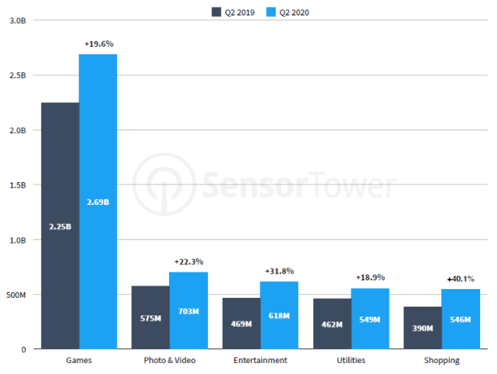
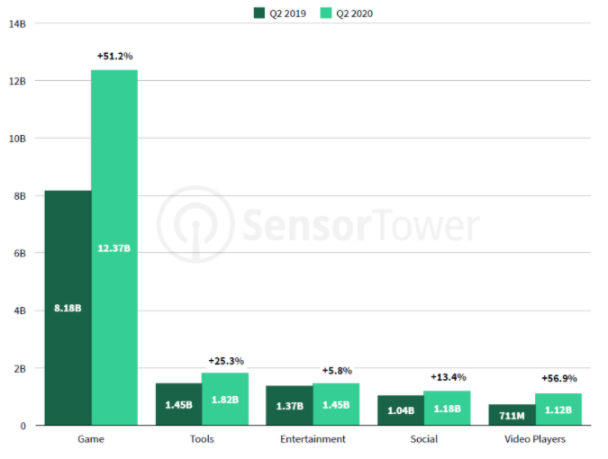
Game Genre in App Store/Google Play
Top App Store app categories. Q2, 2020
Top Google Play app categories. Q2, 2020
Source: SensorTower 2020
Source: SensorTower 2020
Dominance of Games is reflected by its highest percentage share of genres in App Store (46%) and Google Play (74%) in 2020

